Slide 1
TUNABLE SPIN PUMPING INTO SUPERCONDUCTING WIRES
Mikhail Belogolovskii, Elena Zhitlukhina,
Vera Tkachenko, Paul Seidel
Vasyl' Stus Donetsk National University, 21021 Vinnytsia, Ukraine
O.O. Galkin Donetsk Institute for Physics and Engineering,
03028 Kyiv, Ukraine
Friedrich-Schiller-Universität Jena, 07743 Jena, Germany
XIII International Scientific Conference «Electronics and Applied Physics»
Kyiv, October 2017

Slide 2
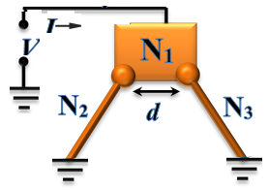
CHARGE PUMPING INTO METALLIC WIRES

Slide 3
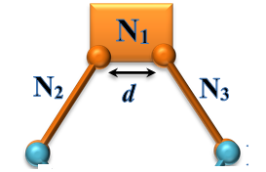
CHARGE PUMPING INTO METALLIC WIRES
d > L_{ϕ}

Slide 4
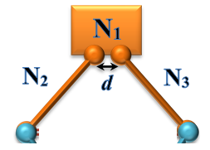
CHARGE PUMPING INTO METALLIC WIRES
d < L_{ϕ}

Slide 5
CHARGE PUMPING INTO METALLIC WIRES

Slide 6
CHARGE PUMPING INTO METALLIC WIRES
;
;

Slide 7
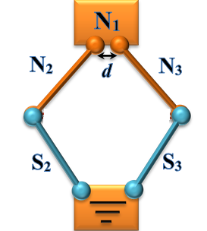
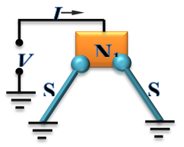
CHARGE PUMPING INTO superconducting WIRES
;
;

Slide 8
CHARGE PUMPING INTO superconducting WIRES
;
;

Slide 9
CHARGE PUMPING INTO superconducting WIRES
;
;

Slide 10



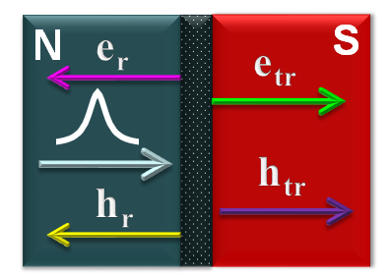
CHARGE PUMPING INTO superconducting WIRES
;
;

Slide 11
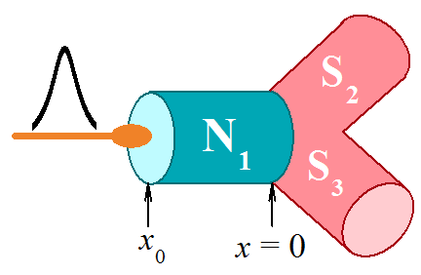


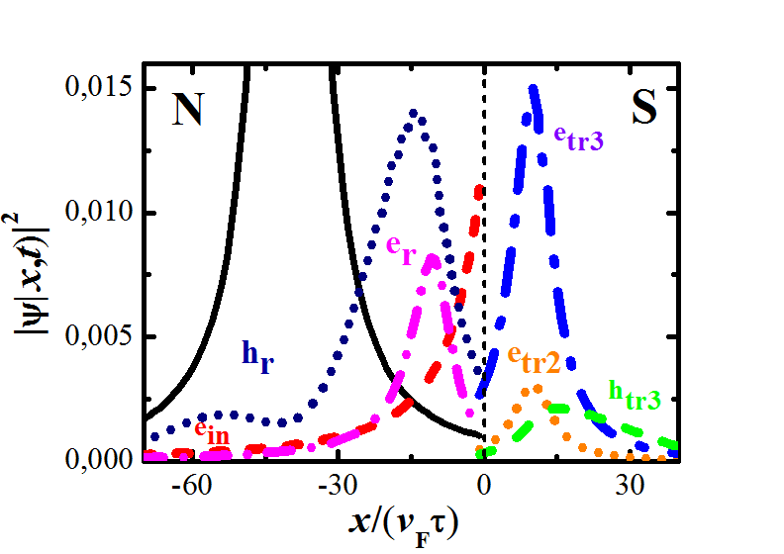
CHARGE PUMPING INTO superconducting WIRES
;
;

Slide 12
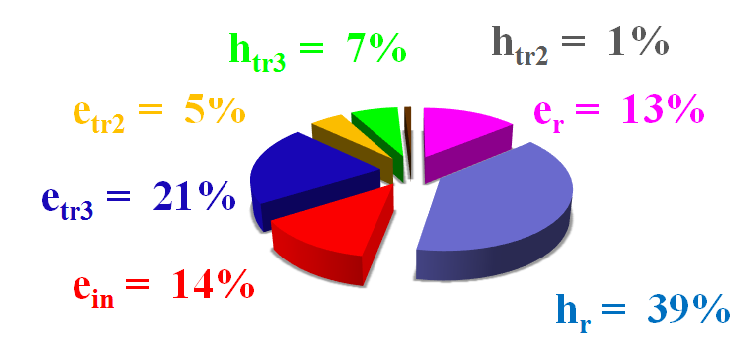
CHARGE PUMPING INTO superconducting WIRES
;
;

Slide 13
tunneling through a magnetic insulator
;
;
Т>T_{c}
Т<T_{c}
∆
∆
NM
I
NM
NM
NM
NM
FMI
NM
FMI
SPIN Pumping with A spin filter

Slide 14
SPIN Pumping with A spin filter
;
;
3
1
2
1
SF
2
SF

Slide 15
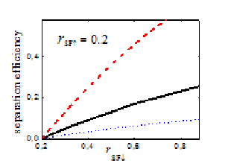
SPIN Pumping with A spin filter
;
;
3
1
2
SF
Dependence of the separation efficiency on different parameters exhibits a spin-filter parameter r_{SF↓} effect on the separation efficiency, r_{SF↑} = 0.2, k₁ = k₂ = k₃ (solid curve), k₂ = 5k₁ = 5k₃ (dashed curve), k₂ = 5k₁ = 5k₂ (dotted curve).

Slide 16
THE END

