Slide 1
SIMULATION OF CURRENT-VOLTAGE CHARACTERISTICS OF LARGE-AREA JOSEPHSON JUNCTIONS
Vera Tkachenko, Oleksii Barybin, Mikhail Belogolovskii
Vasyl' Stus Donetsk National University,
21021 Vinnytsia, Ukraine
XIII International Scientific Conference «Electronics and Applied Physics»
Kyiv, October 2017

Slide 2
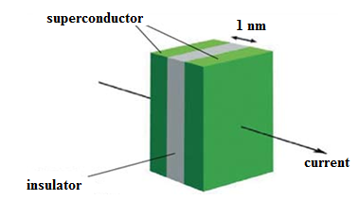
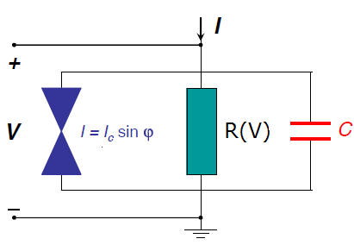
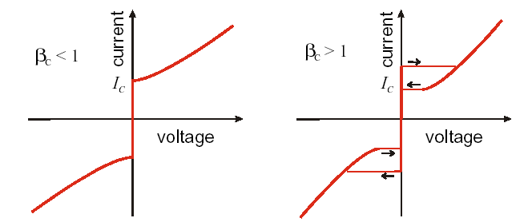
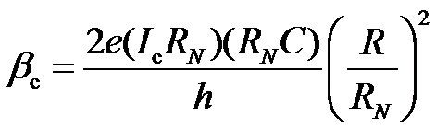

Overdamped (non-hysteretic) Josephson junctions: search of an optimized device
The main idea concerns in the realization of the condition

Slide 3
Overdamped Josephson junctions
with an external resistor
R
Schematic view of a conventional Nb-AlO_{x}-Nb Josephson junction device. Resistor uses considerable space in an integrated circuit thus reducing circuit density and introducing parasitic inductance that degrades circuit performance.

Slide 4
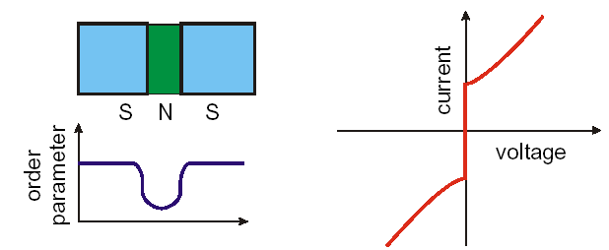
Overdamped (intrinsically shunted) Josephson junctions
small values of R;
extremely small values of C;
β_{с}<<1 for all T;
- comparatively small values of I_{c}R_{N}

Slide 5
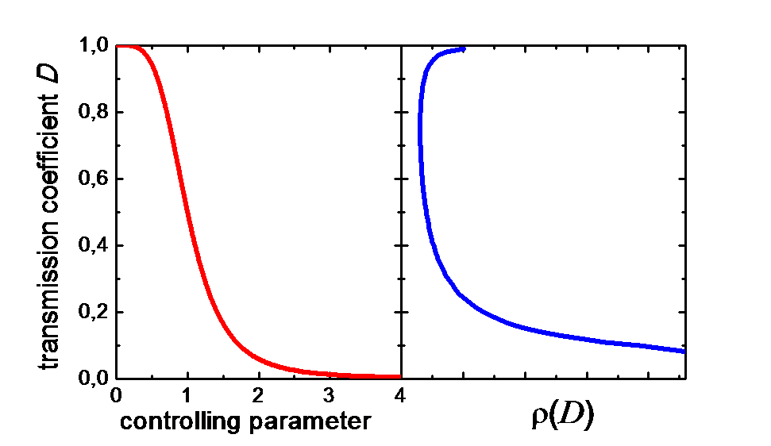
Overdamped (intrinsically shunted) Josephson junctions
We provide a more complete view on the self-shunting problem relating it to specific features of a multi-channel weak link between electrodes where averaging over the channels yields a bimodal distribution of transparencies with maxima near unity and zero.

Slide 6

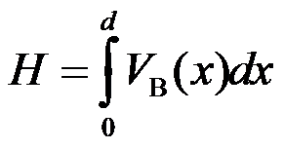
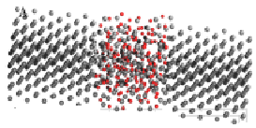
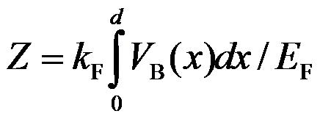
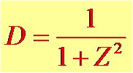
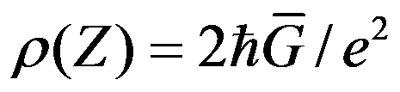

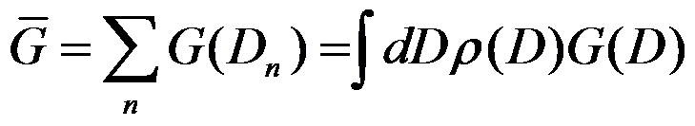
Internal shunting in Nb/Al-AlO_{x}-Nb junctions
Al Al₂O_{2.5} Al
T.C. DuBois et al. Phys. Rev. Lett.
110 (2013) 077002
Assume that

Slide 7
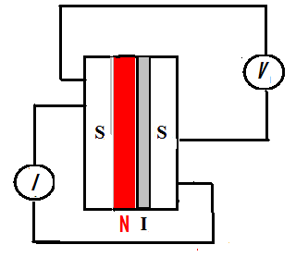


Internal shunting in Nb/Al-AlO_{x}-Nb junctions
The exposure dose was reduced
to 150–500 Pa*s

Slide 8
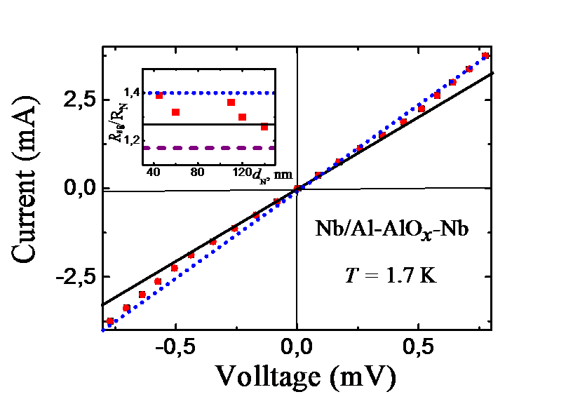
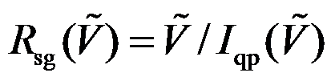
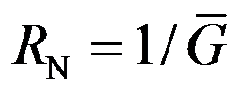
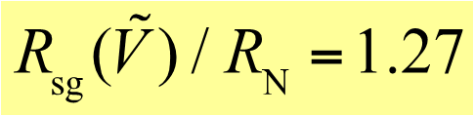
Internal shunting in Nb/Al-AlO_{x}-Nb junctions
N-I-S
S/N-I-S
quasi-clean case
S/N-I-S
dirty case
Theory

Slide 9
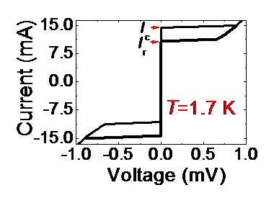
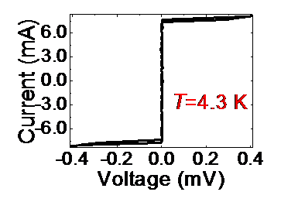
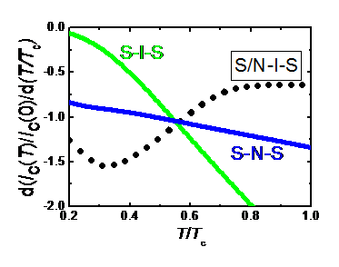
Internal shunting in Nb/Al-AlO_{x}-Nb junctions
The first step is the use of disordered 1 nm-thick oxide layers to suppress the McCumber-Stewart parameter at very low temperatures
The second step is the additional suppression of the McCumber-Stewart parameter at temperatures above 4 К.
Additional advantage is the increased temperature stability at temperatures above 4 K.

Slide 10
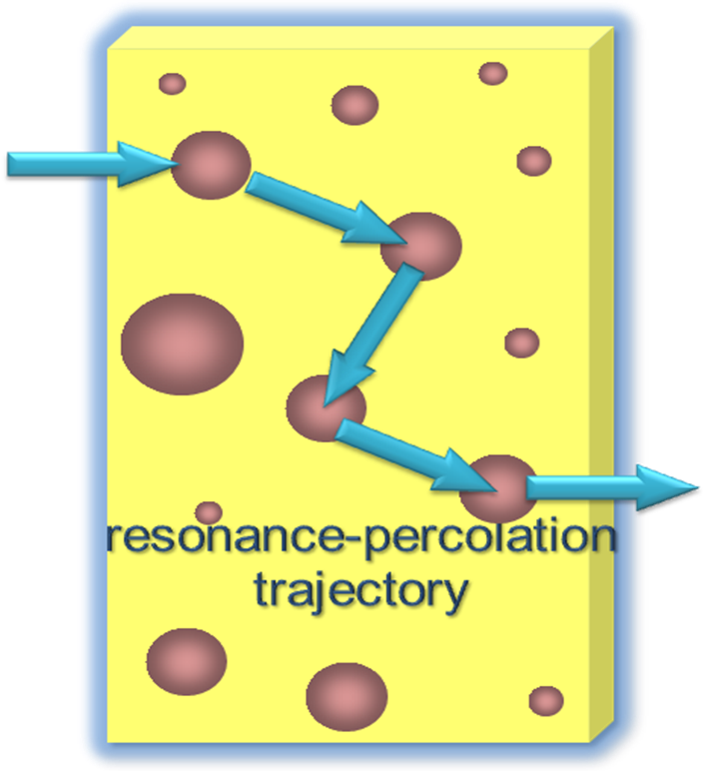
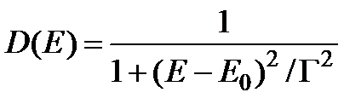
Internal shunting in MoRe/W:Si-Si-MoRe junctions
MoRe alloy
W
Si
MoRe alloy
Type-II samples
MoRe alloy
W
Si
MoRe alloy

Slide 11

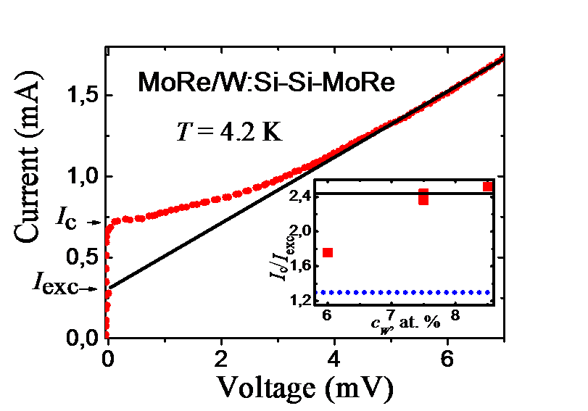


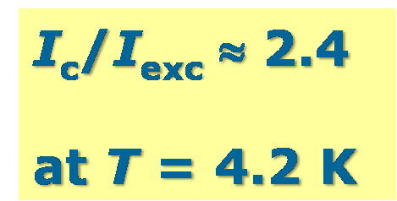
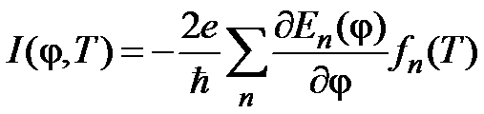
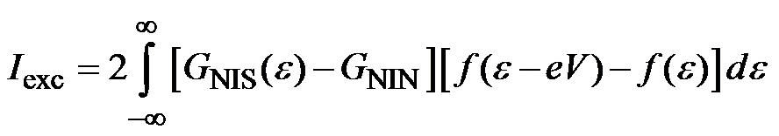
Internal shunting in MoRe/W:Si-Si-MoRe junctions

Slide 12
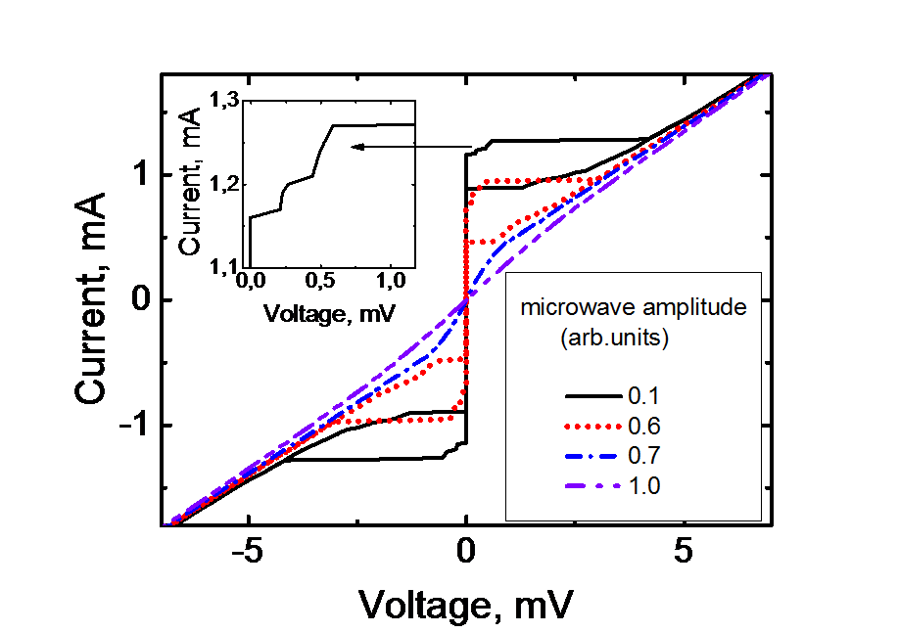
Internal shunting in MoRe/W:Si-Si-MoRe junctions
I-V curves of MoRe-Si(W)-MoRe junctions in the presence of external
microwave irradiation at f = 11 GHz for five representative microwave
amplitudes, T = 4.2 K. The inset shows first two Shapiro steps observed
for the lowest microwave power.

Slide 13
Perspectives
Disorder is a rich and fertile subject area whose wealth of surprisingly physical effects are only now being discovered. There is still much work to be done in terms of both fundamental physics and potential applications, and no doubt yet more surprises lie in store.
Nature Photonics, 2013

Slide 14
THE END

