Slide 1


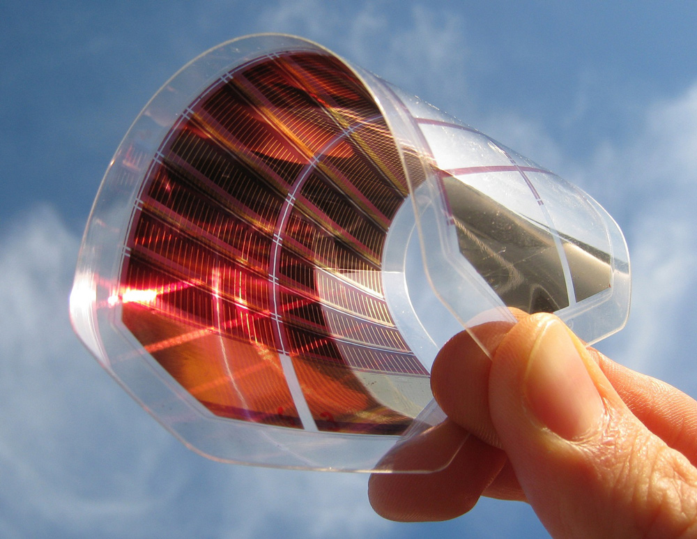
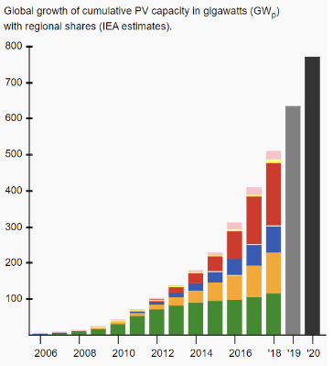

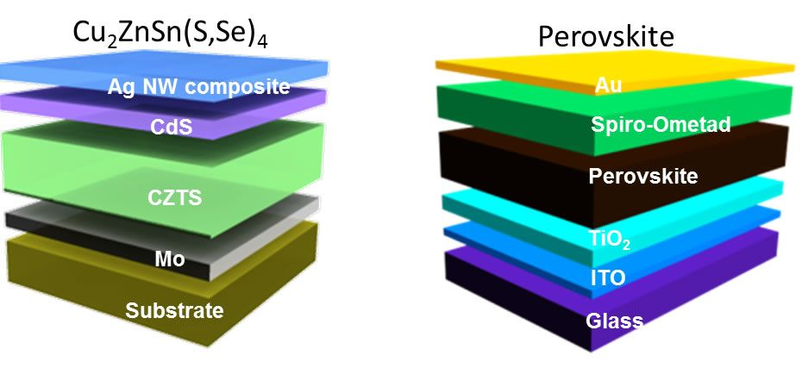
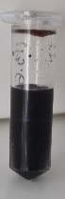
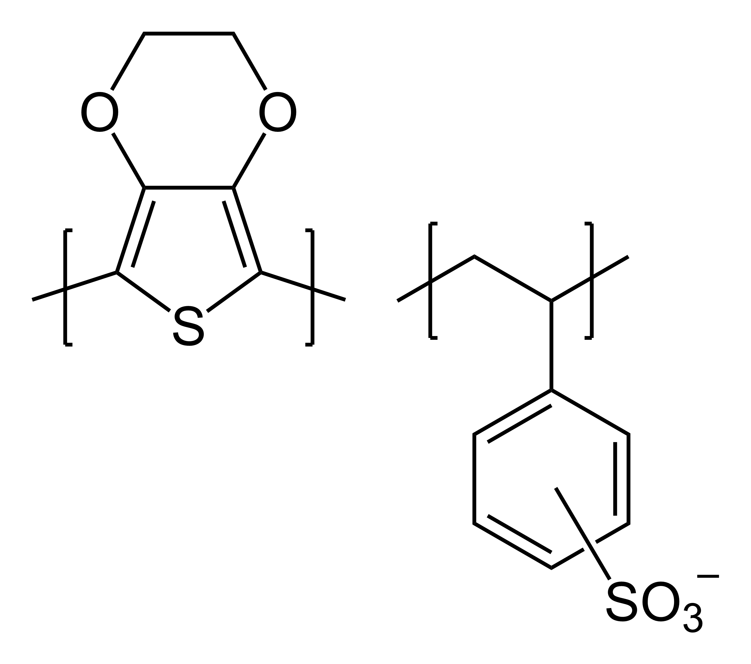
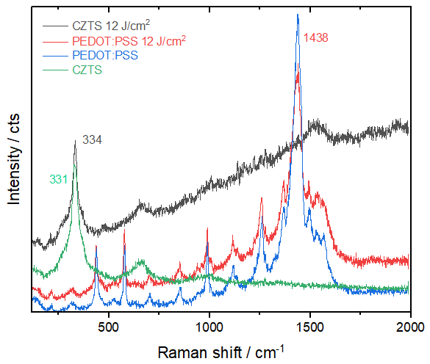

Raman study of the Flash-lamp annealing influence to Cu₂ZnSnS₄ nanocrystals and PEDOT:PSS composite thin films
Yevhenii Havryliuk^{1,2,3}, Volodymyr Dzhagan³, Anatolii Karnauhov³, Oleksandr Selyshchev^{1,2}, Dietrich R.T. Zahn^{1,2}
¹ Semiconductor Physics, Chemnitz University of Technology, Chemnitz, Germany
² Center for Materials, Architectures, and Integration of Nanomembranes (MAIN), Chemnitz, Germany
³ V.E. Lashkaryov Institute of Semiconductor Physics NAS of Ukraine, Kyiv, Ukraine
Motivation
The increasing demand for energy as well as ecological issues enhances research in the areas of renewable sources.
One of the current trends is thin-film photovoltaic (PV). To improve properties of thin-film PV devices as well as to combine PV and thermoelectric (TE) effects researchers look towards replacing Si as an absorber layer with alternative affordable and environment-friendly materials with much stronger light absorption, TE properties, and lower cost of production.
Picture from: https://utrecht.materialdistrict.com/thin-film-solar-cells/
Data from Wikipedia
Cu₂ZnSnS₄ nanocrystals (CZTS NCs) - perspective materials for renewable energy
Advantages:
Issues:
Perspectives:
non-toxic and abundant constituents;
high absorption coefficient in the whole visible range
(up to an order of magnitude higher than that of Si)
- possibility of "green" colloidal synthesis.
- multiple structural modifications;
- secondary phases;
- a lot of intrinsic defects.
PV power conversion already reached 12,6%;
pronounced TE properties;
- new composites obtained by mixing CZTS NCs colloidal solution with conductive polymers;
- enhancing of PV and TE properties not only by (post-)synthesis treatment (e.g. different deposition methods and conditions, thermal or flash-lamp annealing of the films) but also by varying the stoichiometry.
Wan-Ching Hsu, et al., Science, 345, 542 (2014)
S. Bourdais et al. Adv. Energy Mater. 1502276, 1 (2016)
PEDOT:PSS – very vell known conductive polymer
improving of properties by adding nanoparticles
easy tunable electrical and thermoelectrical properties
can be used for thin-film transparent solar cells
poly(3,4-ethylenedioxythiophene) polystyrene sulfonate
Results & discussion
CZTS NCs + PEDOT:PSS composite
Shift of PEDOT:PSS peak in composite
The aqueos colloidal solution of CZTS NCs with average size of 5 - 10 nm obtained by us with „green“ synthesis mixed in different volume ratios of PEDOT:PSS, deposited to glass substrate and Raman spectra are taken
Presence of TGA as a ligand and possible presence of small amount in NCs solution
Mixture of PEDOT:PSS with expected TGA amount and supernatant prepared
Shifting of the characteristical modes of CZTS NCs and PEDOT:PSS in the composite compound compared to the pure materials confirms the interaction between these two materials.
Similar behaviour of PEDOT:PSS main peak. No clear answer about the reason of the shift
Further detailed investigation of this question required
Flash-lamp annealing
12 J/cm² FLA energy density was chosen as an optimal one from the previous results
Expected crystalline quality improvement for pure CZTS NCs
Almoust no influence on PEDOT:PSS
Even more improvement of crystalline quality of CZTS NCs in composite compound compared to pure CZTS NCs and complete decomposition of PEDOT:PSS
PEDOT:PSS plays protective role for CZTS NCs „hot spots“
Summary
Acknowledgment
- For the first time the Raman scattering spectra of CZTS NCs in PEDOT:PSS matrix with CZTS NCs concentration from 0% to 100% were obtained and analysed. It is shown that with varying concentration of CZTS NCs changes occur in both.
- The shift of PEDOT:PSS characteristic peak observed for mixing PEDOT:PSS with supernatant, highly diluted TGA and NaOH, what require further investigation.
- For the first time the influence of the FLA treatment to the mixed CZTS NCs and PEDOT:PSS composite were investigated. The better improvement of CZTS NCs crystalline quality in composite observed due to PEDOT:PSS plays protective role.

